Slide 1
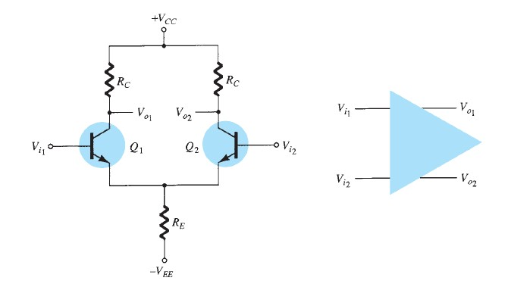
University of Diyala College of Engineering
Department of Communications Engineering
Electronics II: 3^{ed} Year - 2015/2016 By: Hussein Ahmed Mahmood
DIFFERENTIAL AMPLIFIER CIRCUIT
The differential amplifier circuit is an extremely popular connection used in IC units. This connection can be described by considering the basic differential amplifier shown in Fig.1. Notice that the circuit has two separate inputs and two separate outputs, and that the emitters are connected together. Whereas many differential amplifier circuits use two separate voltage supplies, the circuit can also operate using a single supply.
Fig.1
Basic differential amplifier circuit
If an input signal is applied to either input with the other input connected to ground, the operation is referred to as "single-ended."
If two opposite-polarity input signals are applied, the operation is referred to as "double-ended."
If the same input is applied to both inputs, the operation is called "common-mode."

Slide 2
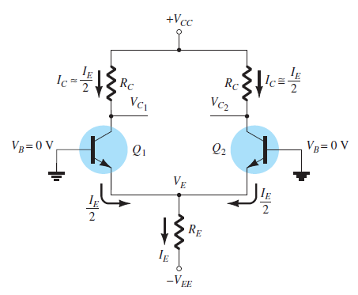
University of Diyala College of Engineering
Department of Communications Engineering
Electronics II: 3^{ed} Year - 2015/2016 By: Hussein Ahmed Mahmood
The main feature of the differential amplifier is the very large gains when opposite signals are applied to the inputs as compared to the very small gain resulting from common inputs. The ratio of this difference gain to the common gain is called common-mode rejection.
DC Bias
Let's first consider the dc bias operation of the circuit of Fig.1. With ac inputs obtained from voltage sources, the dc voltage at each input is essentially connected to 0 V, as shown in Fig. 2. With each base voltage at 0 V, the common-emitter dc bias voltage is
Fig. 2
DC bias of differential amplifier circuit.

Slide 3
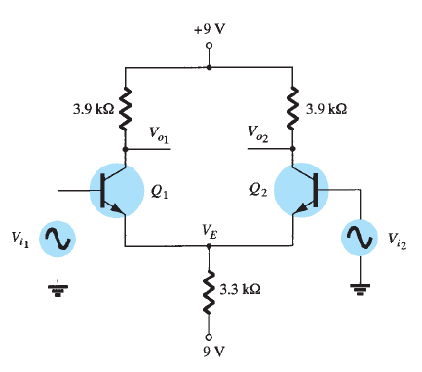
University of Diyala College of Engineering
Department of Communications Engineering
Electronics II: 3^{ed} Year - 2015/2016 By: Hussein Ahmed Mahmood
The emitter dc bias current is then
Assuming that the transistors are well matched (as would occur in an IC unit), we obtain
Resulting in a collector voltage of
EXAMPLE (1). Calculate the dc voltages and currents in the circuit of Fig. 3.
Fig. 3
Solution:

Slide 4
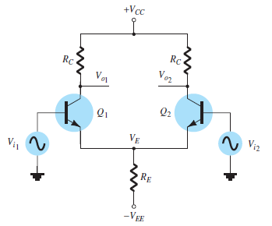
University of Diyala College of Engineering
Department of Communications Engineering
Electronics II: 3^{ed} Year - 2015/2016 By: Hussein Ahmed Mahmood
The collector current is then
resulting in a collector voltage of
The common-emitter voltage is thus -0.7 V, whereas the collector bias voltage is near 4.1V for both outputs.
AC Operation of Circuit
An ac connection of a differential amplifier is shown in Fig. 4. Separate input signals are applied as V_{i1} and V_{i2}, with separate outputs resulting as V_{o1} and V_{o2}. To carry out ac analysis, we redraw the circuit in Fig. 5. Each transistor is replaced by its ac equivalent.
Fig. 4
AC connection of differential amplifier.

Slide 5
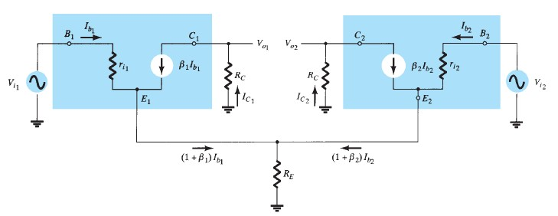
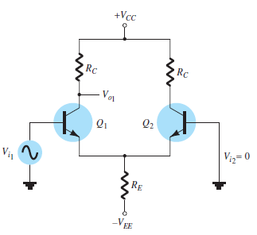
University of Diyala College of Engineering
Department of Communications Engineering
Electronics II: 3^{ed} Year - 2015/2016 By: Hussein Ahmed Mahmood
Fig. 5
AC equivalent of differential amplifier circuit
Single-Ended AC Voltage Gain:- To calculate the single-ended ac voltage gain, Vo/V_{i}, apply signal to one input with the other connected to ground, as shown in Fig. 6.
Fig. 6

Slide 6
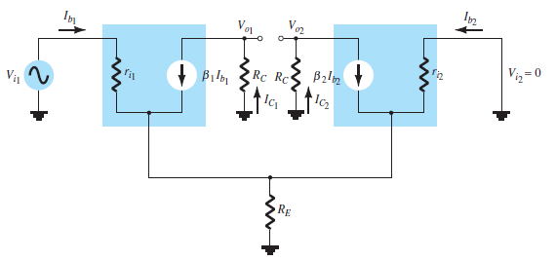
University of Diyala College of Engineering
Department of Communications Engineering
Electronics II: 3^{ed} Year - 2015/2016 By: Hussein Ahmed Mahmood
Fig. 7
AC equivalent of circuit in Fig. 6.
The ac equivalent of this connection is drawn in Fig. 7. The ac base current can be calculated using the base 1 input Kirchhoff voltage loop (KVL) equation. If one assumes that the two transistors are well matched, then
With R_{E} very large (ideally infinite), the circuit for obtaining the KVL equation simplifies to that of Fig. 8, from which we can write.
So that

Slide 7
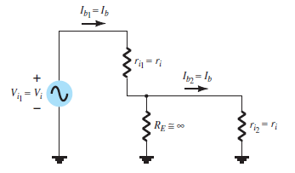
University of Diyala College of Engineering
Department of Communications Engineering
Electronics II: 3^{ed} Year - 2015/2016 By: Hussein Ahmed Mahmood
If we also assume that
Then
and the output voltage magnitude at either collector is
Fig. 8
Partial circuit for calculating I_{b}.
for which the single-ended voltage gain magnitude at either collector is

Slide 8
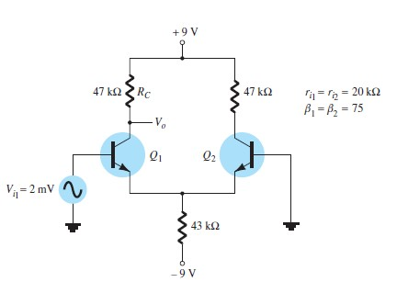
University of Diyala College of Engineering
Department of Communications Engineering
Electronics II: 3^{ed} Year - 2015/2016 By: Hussein Ahmed Mahmood
EXAMPLE (2):- Calculate the single-ended output voltage V_{o1} for the circuit of Fig. 9.
Fig. 9
Solution: The dc bias calculations provide
The collector current is then
So that
The value of r_{e} is then
The ac voltage gain magnitude can be calculated

Slide 9
University of Diyala College of Engineering
Department of Communications Engineering
Electronics II: 3^{ed} Year - 2015/2016 By: Hussein Ahmed Mahmood
providing an output ac voltage of magnitude
Double-Ended AC Voltage Gain:- A similar analysis can be used to show that for the condition of signals applied to both inputs, the differential voltage gain magnitude is
Where
V_{d} = V_{i1} – V_{i2} .
Common-Mode Operation of Circuit:- Whereas a differential amplifier provides large amplification of the difference signal applied to both inputs, it should also provide as small an amplification of the signal common to both inputs. An ac connection showing common input to both transistors is shown in Fig. 10. The ac equivalent circuit is drawn in Fig. 11, from which we can write.
which can be rewritten as
The output voltage magnitude is then

Slide 10
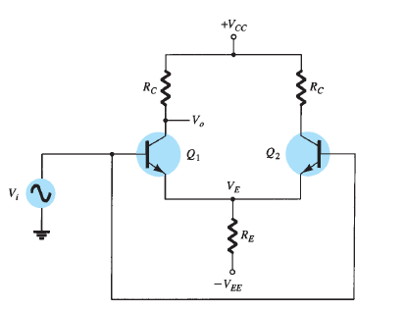
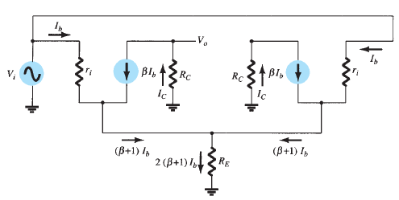
University of Diyala College of Engineering
Department of Communications Engineering
Electronics II: 3^{ed} Year - 2015/2016 By: Hussein Ahmed Mahmood
providing a voltage gain magnitude of
Fig. 10
Common-mode connection.
Fig. 11
AC circuit in common-mode connection.

